Slide 1
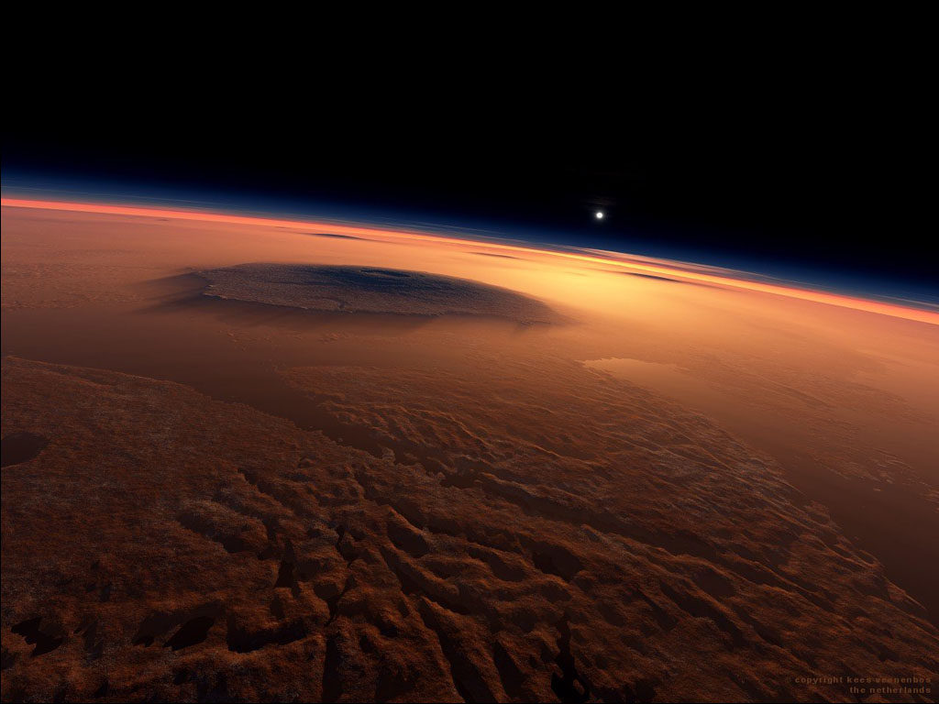
Large Crater Cluster Analysis and
GIS
Geologic and Stratigraphic Implications in the Martian Northern Plains
Richard A Nava
Northern Arizona University (NAU)
United States Geological Survey (USGS)

Slide 2
Scientific Objectives
To improve temporal constraints of Martian geologic processes
Understand the formational history of the planet
Provide adequate context for exploration

Slide 3
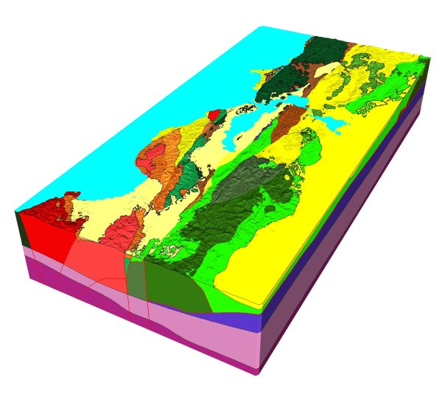
Geologic Processes in Time
Geology on EARTH
Delineation of different Units
Stratigraphy
Physical arrangement of packages of geologic material
Layers
Which came first?

Slide 4
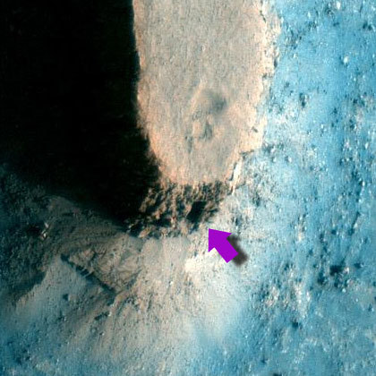
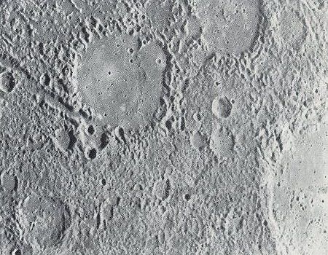
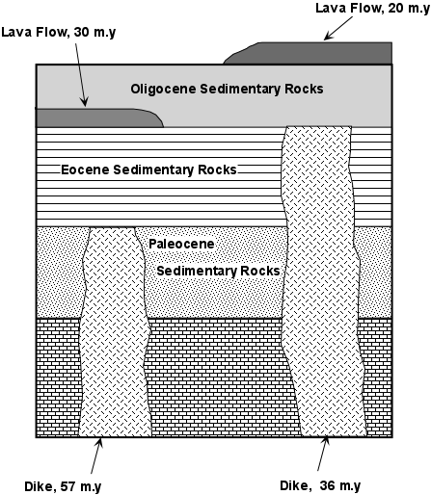
Current Methodology - MARS
Temporal Assessments on MARS
Morphology
Crater size-density distributions
Cross-cutting relationships (Stratigraphy)
Interpretive

Slide 5
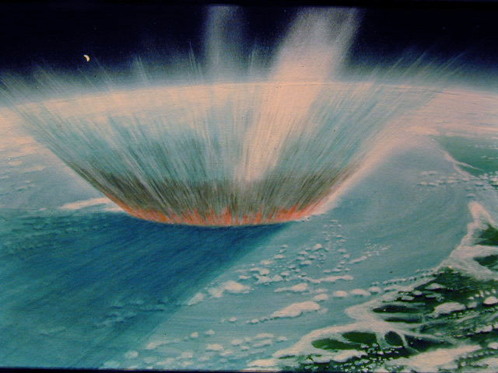
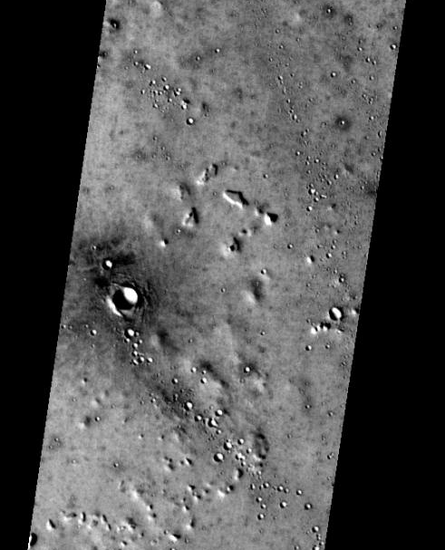
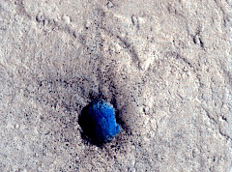
Impact Craters - Characteristics
Some show alignment
Large Primary Impact
23 km
Possible Secondary impacts from large impact ejecta

Slide 6
Large Crater Clusters
≥ 20 km in length
Containing ≥ 10 individual craters
≥ 300 m in diameter
100 Km
Develop a process:
For refining the current Stratigraphic framework
A method that is repeatable
systematic

Slide 7
Geographic Information Systems (GIS)
GIS Tool Development
Systematic
Repeatable
Existing tools
Parameters:
  Cluster Analysis
  Query by Distance
  Ellipse Size
1
2
3
Built-In Tools
Code
User Interface

Slide 8
Geographic Information Systems (GIS)
New Methodology:
1
2
3
4
5
25 Km
1. Identify LCCs
2. Determine statistical boundaries
3. Create Directional Distribution Ellipses
4. Extend ellipse major axis around the globe
5. Find potential source sites from line intersections

Slide 9
GIS Attributes / Information
Differentiate Between Impact Processes
25 Km
Crater Statistics
Secondary
Impacts?
> Elliptical > Linear
Source: YES
Ellipticity
Primary
Impacts?
< Elliptical < Linear
Source: NO

Slide 10
Scientific Objective
Stratigraphic Relationships
Between Units
Unit A
Source
Unit C
Source
Cluster
Cluster
Cluster
Unit B
Cluster
Cluster
Unit A

Slide 11
Project Status
Program under development
    Add more parameters
Testing on larger data-sets
Calibration against known Secondary Clusters
    Pending

Slide 12
Goals
Back-track LCCs to source craters
Assess cluster origin
Retrieve crater statistics
Differentiate between primary and secondary craters
Quantify stratigraphic relationships

Slide 13
Thank You
Questions?
Richard A Nava
Northern Arizona University (ran42@nau.edu)
United States Geological Survey (rnava@usgs.gov)

